Slide 1
Drawing with Music -Kinetic Drawing -Mark-Making -String Painting
Jennifer Kay-Rivera, Ed.S.
jrivera@wcskids.net
Warren Consolidated Schools
Sterling Heights High School

Slide 2
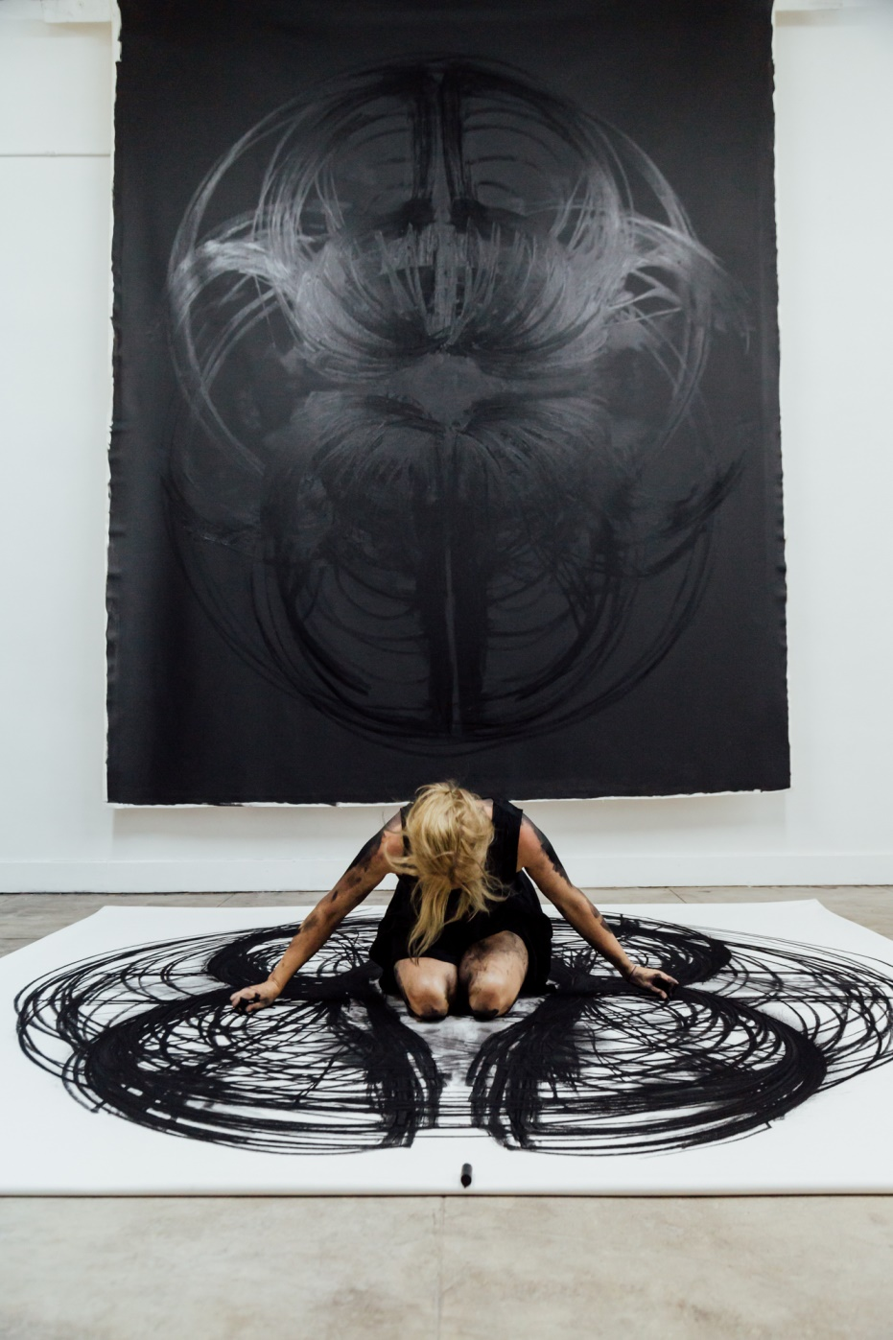
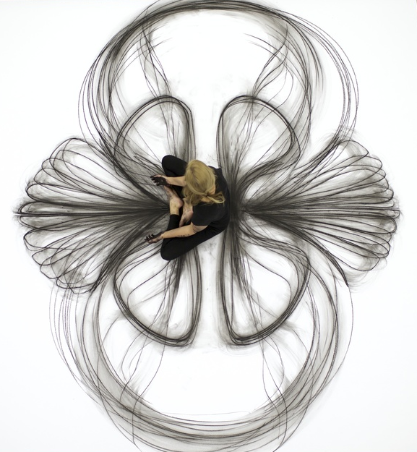
Heather Hansen- Kinetic Drawing
Dancer
Fine Artist
New Orleans

Slide 3
https://vimeo.com/91252556

Slide 4
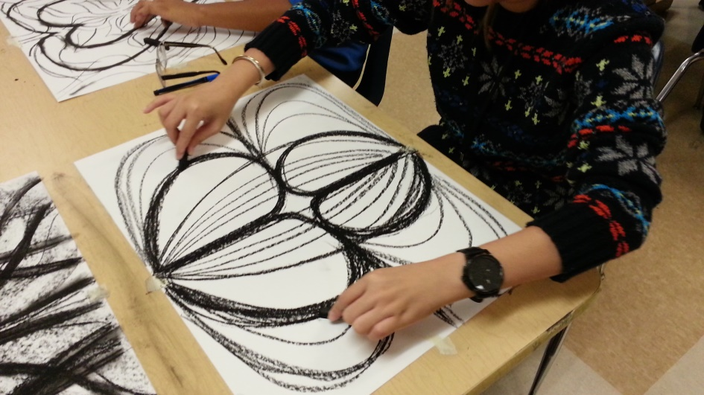
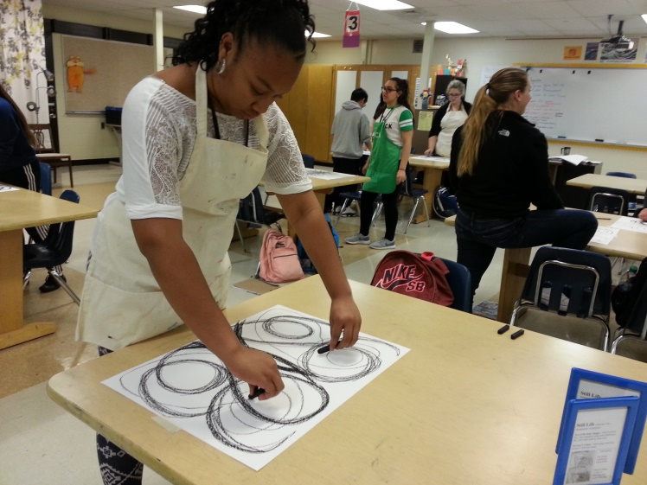
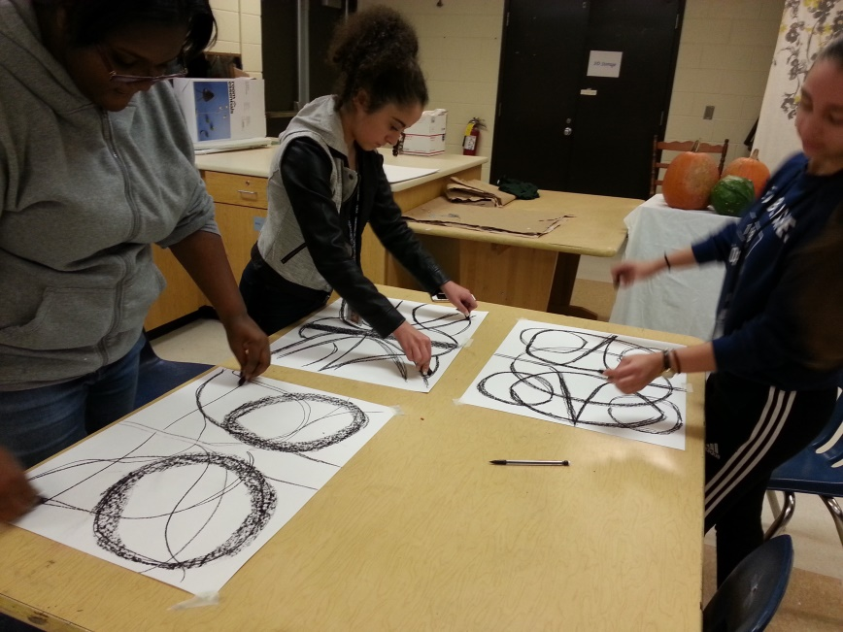
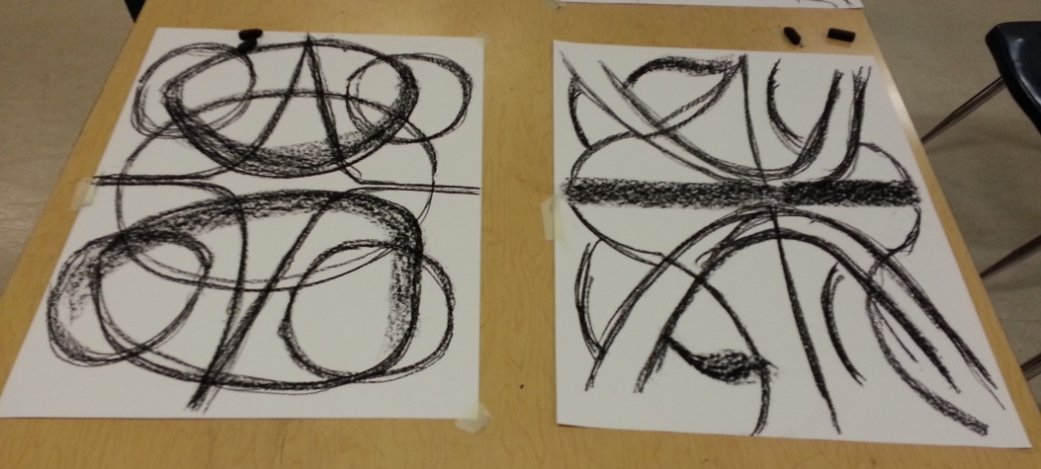
Kinetic Drawing
2 sticks of charcoal or chalk pastels

Slide 5
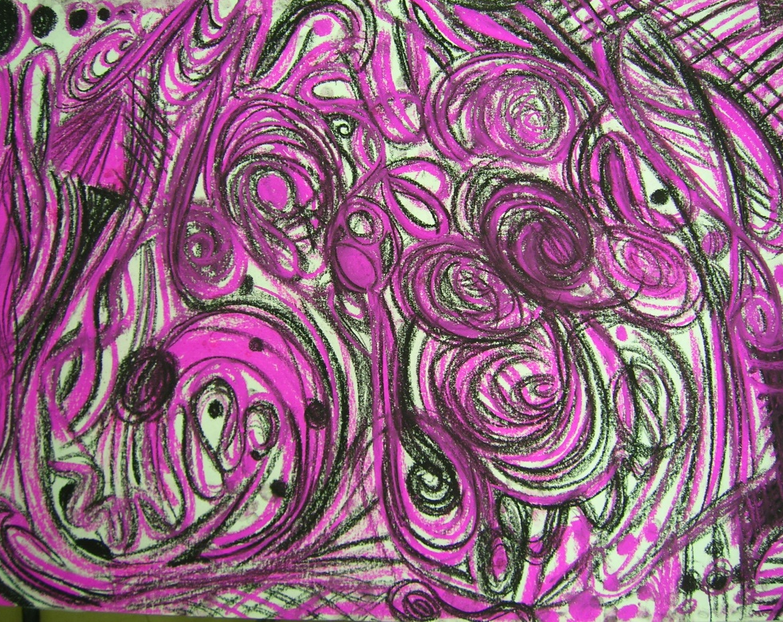
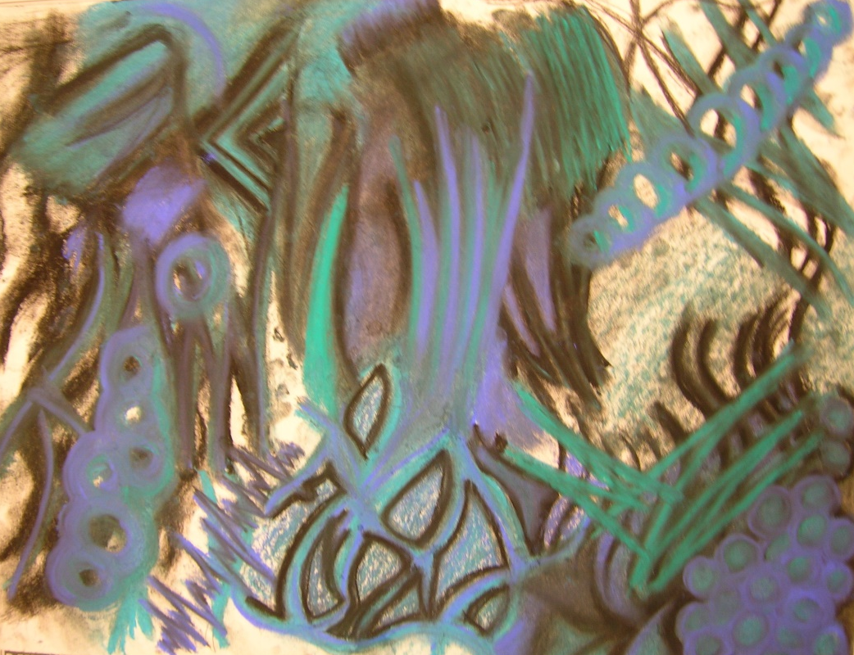
Drawing to Music ~ Mark-making

Slide 6
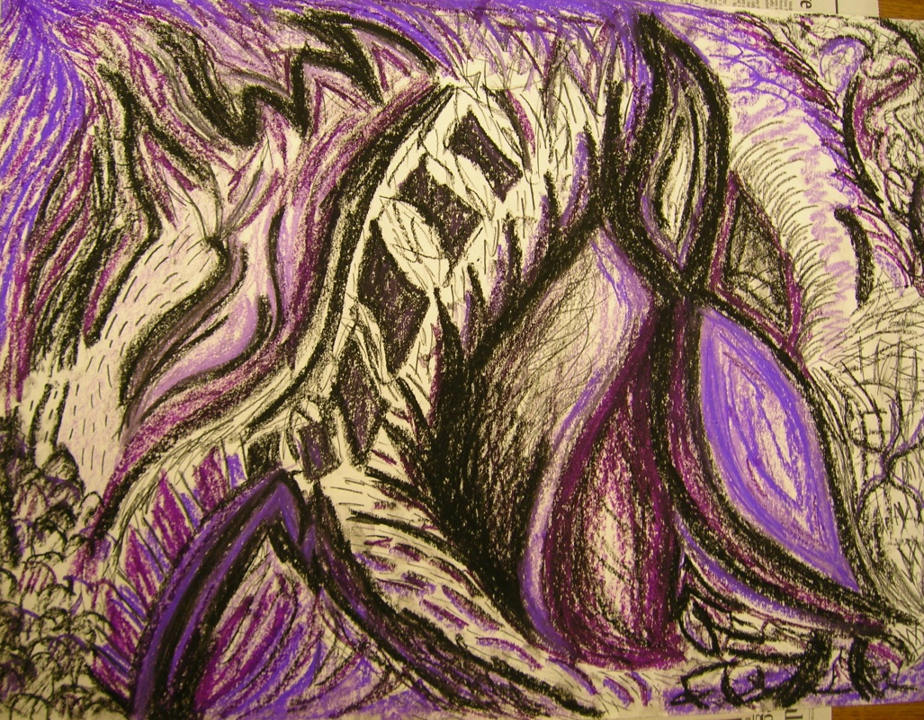
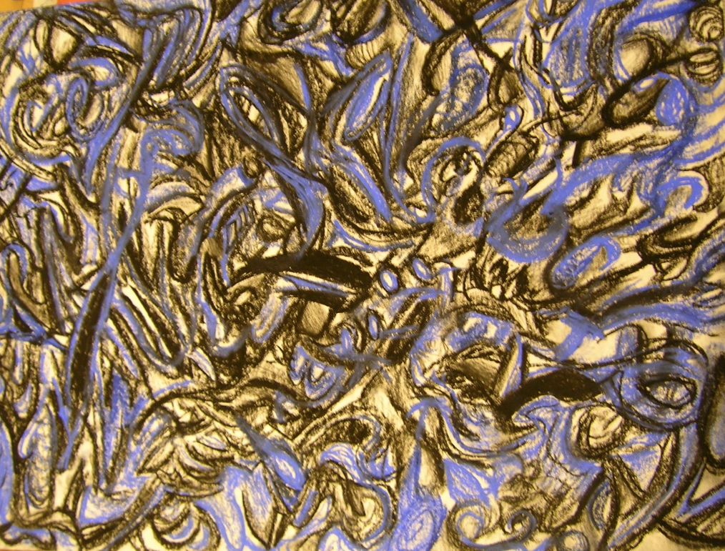

Slide 7
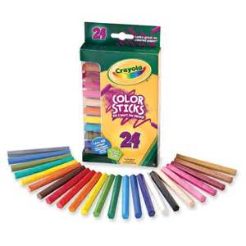
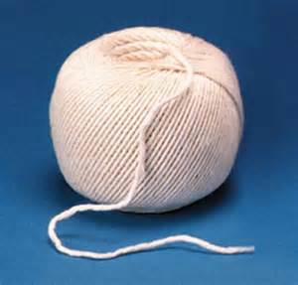
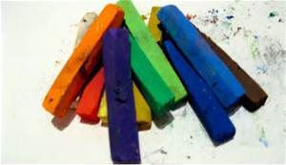
String Painting
Materials
Ink
String
Paper
Pastels
Colored Pencils
Colored Sticks

Slide 8
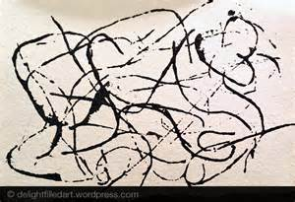
String Painting w/Ink

Slide 9
Add colored media

Slide 10
Use view finder to cut squares

Slide 11
Rework the mini compositions

Slide 12
Assemble Tiles, Glue to Paper

