Slide 1
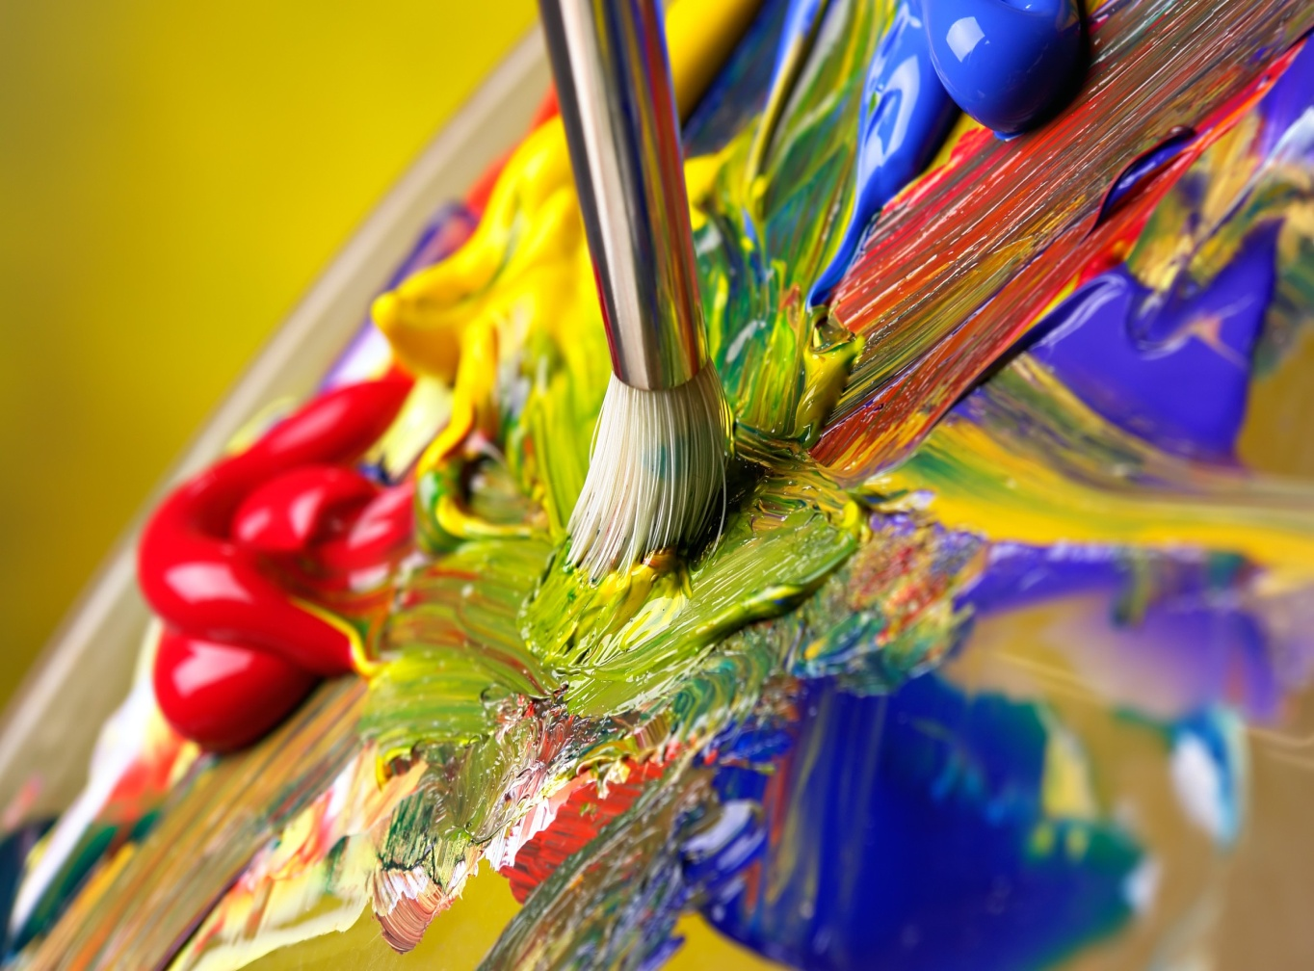
Color! Light must be present to see color

Slide 3
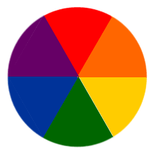
Color Code the Color Wheel
Red
Violet Orange
Blue Yellow
Green

Slide 4
Primary Colors these colors make all the colors on the color wheel
Red
Yellow
Blue

Slide 5
Secondary Colors colors made from the primary colors
Orange
Green
Violet/Purple

Slide 6
Intermediate Colors colors made from a primary & secondary color
Red-Orange
Yellow-Orange
Yellow-Green
Blue-Green
Blue-Violet
Red-Violet

Slide 7
Complimentary Colors opposite from each other on the color wheel
Red
Yellow
Blue
Green
Violet/Purple
Orange

Slide 8
Sports Teams use Complimentary Colors

Slide 9
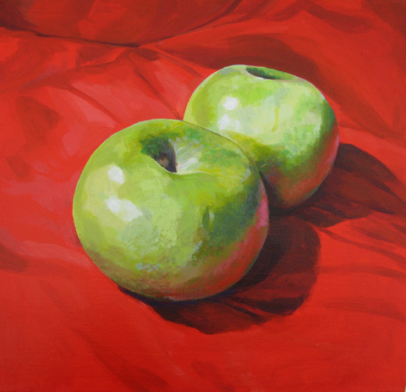

Slide 10
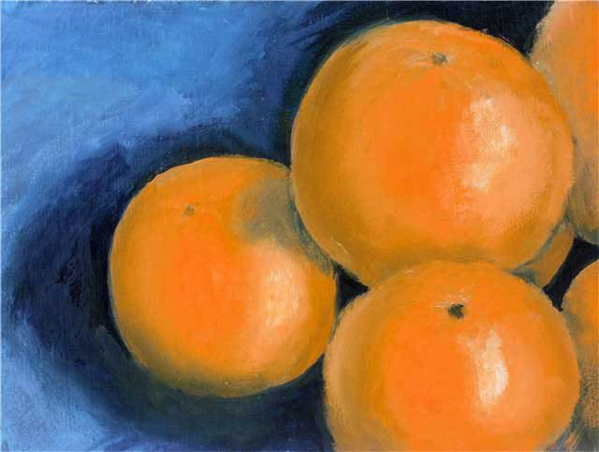

Slide 11
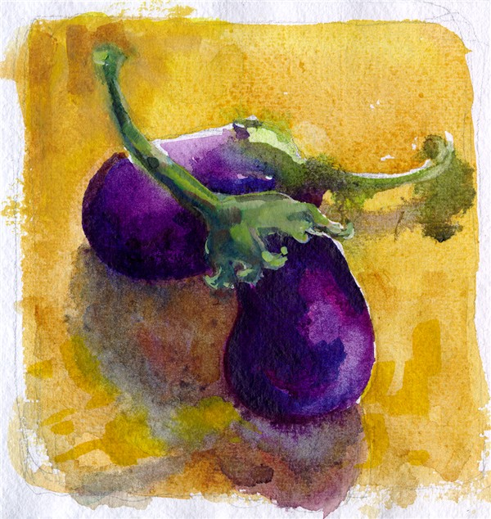

Slide 12
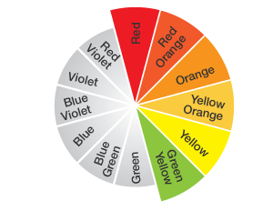
Warm Colors
Red’s – Orange’s – Yellow’s

Slide 13
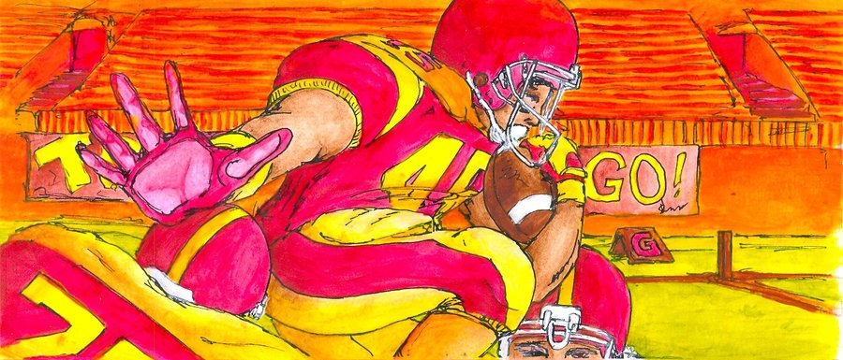
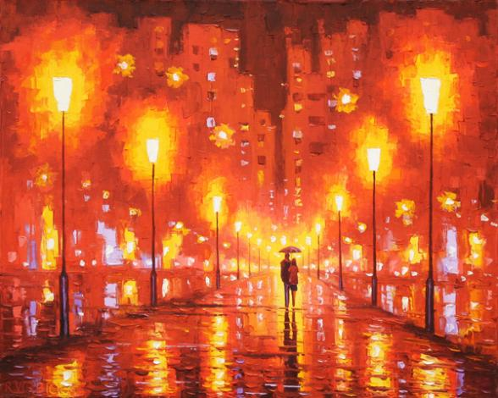

Slide 14
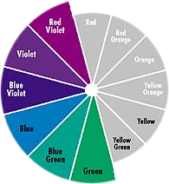
Cool Colors
Green’s – Blue’s – Violet’s

Slide 15
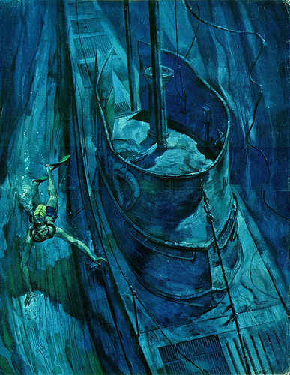

Slide 16
Analogous Colors 3 or 4 colors that are next to each other
Red Red-Orange Orange
Blue Blue-Green Green Yellow-Green

Slide 17
Gradient Scale Uses a value, gradually changes from lightest to the darkest (synonym: value scale)

Slide 18
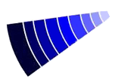
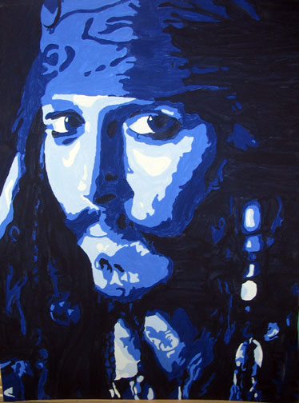
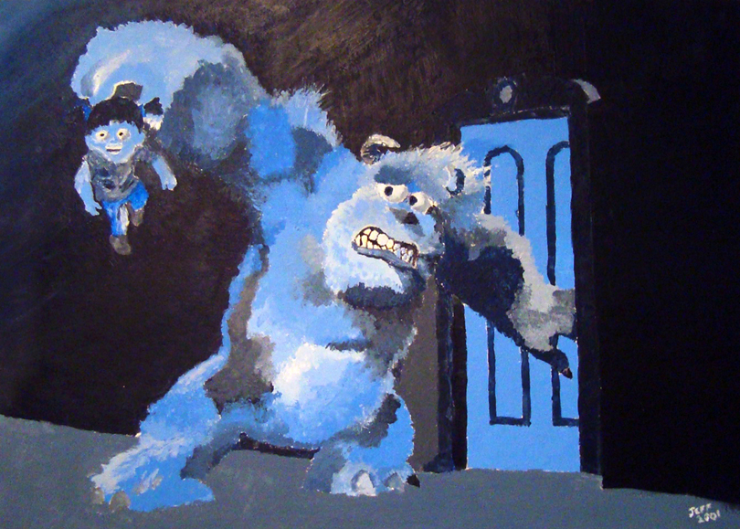
Monochromatic uses ONE color from the lightest to the darkest of this color (like a gradient or value scale)

Slide 19
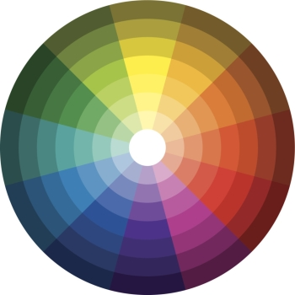
Examples of Monochromatic

Slide 20
Tint Adding white to a color
Shade Adding black to a color

Slide 21
Intensity How vibrant or bright the color is

Slide 22
Value The lightness or darkness of a color

Slide 23
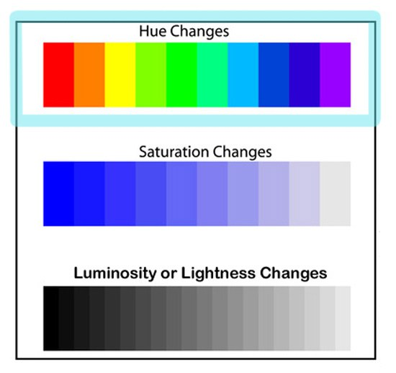
Hue a true color or shade

Slide 24
ROYGBV
An acronym for remembering the order of the colors on the color wheel
Think of this like the name Roy G. Bv
ROYGBV

Slide 25
Review on your own
Now that you finished the notes, fill in this worksheet based on what you just learned.

