Slide 1
Warren Education Association poster contest
American Education Week

Slide 2
Criteria
*K-12 students from each school in the district will participate.
*Poster must be on a 12” x 18” sheet of construction paper.
*Mediums: Colored Pencils, Crayons, Markers
*All applications must have an “Entry Form” filled out and attached to the back of them.

Slide 3
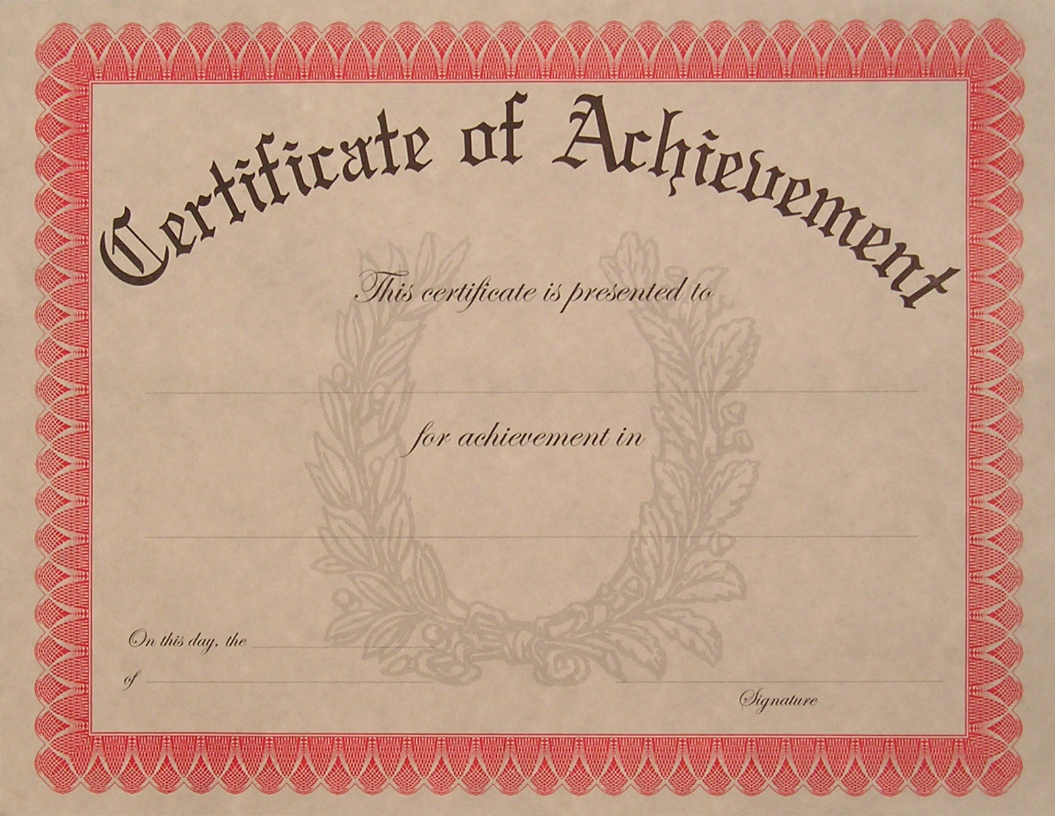
Selection Process
*Each grade level will have one winner in each school.
*A panel of judges will select one winner from each grade level to represent the entire school district.
*There will be 15 district wide winners in all.
*All grade level winners in every building will be honored at a Board of Education meeting. They will be informed of the date in an invitation.
*All winners will receive a certificate from the Board of Education and the Warren Education Association.
*The 15 district wide winners will receive a $50 Barnes and Noble gift certificate from the Warren Education Association.

Slide 4
2013 Theme
“Public Education-
We Enter to Learn,
Leave to Achieve”

Slide 6
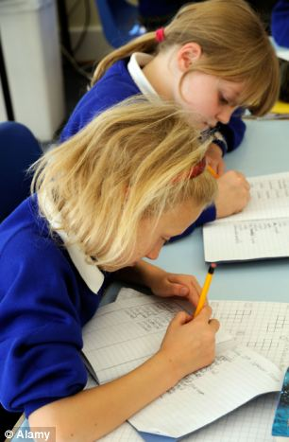

Slide 8
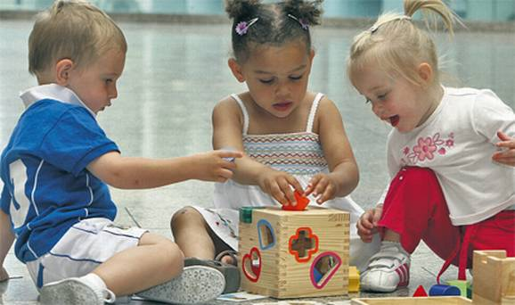
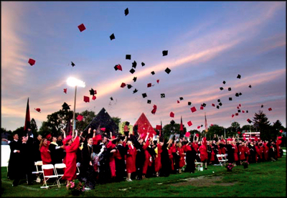

Slide 9
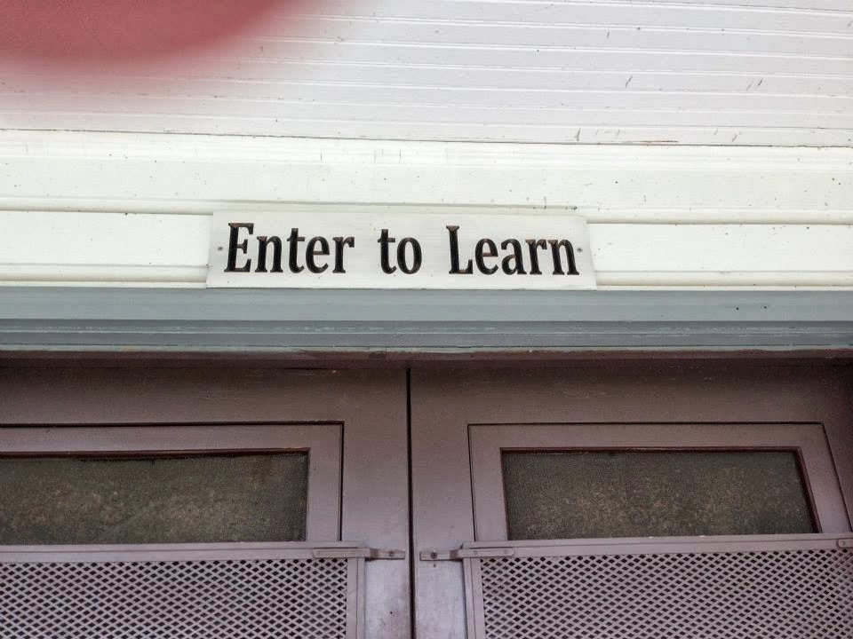
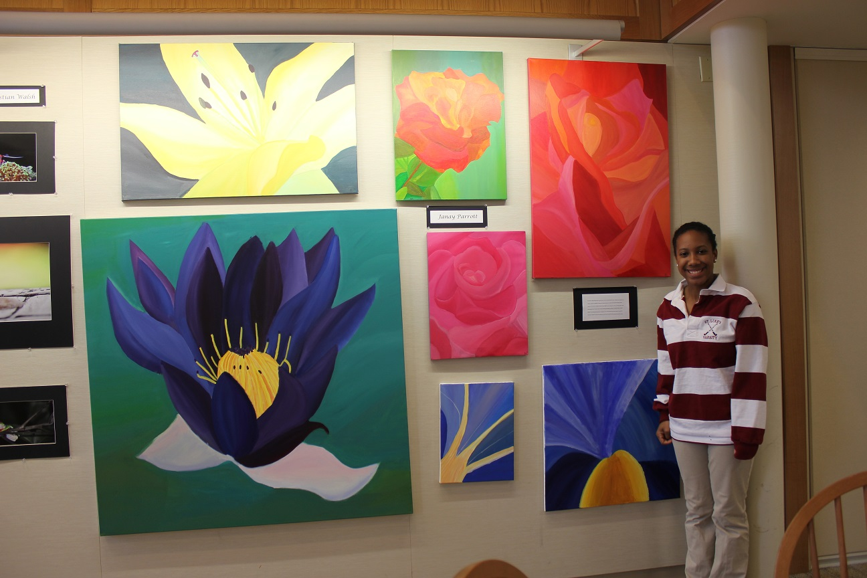
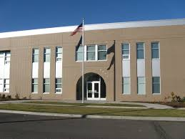

Slide 10
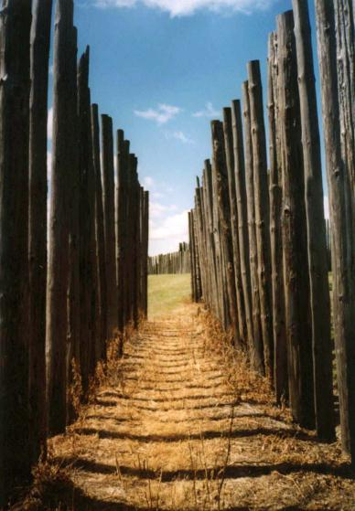
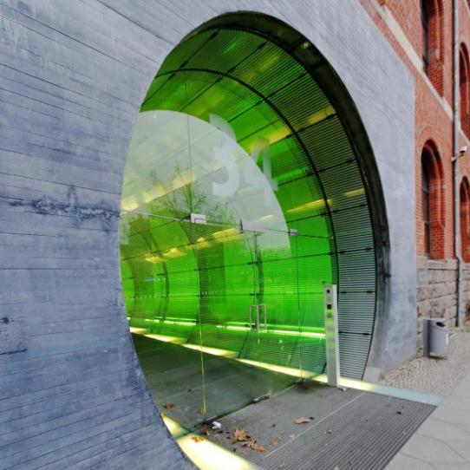

Slide 11
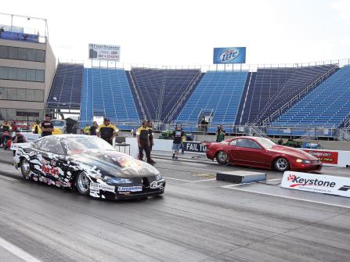

Slide 14
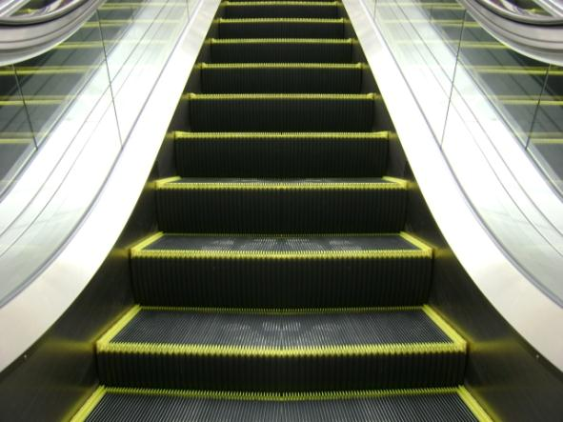

Slide 16
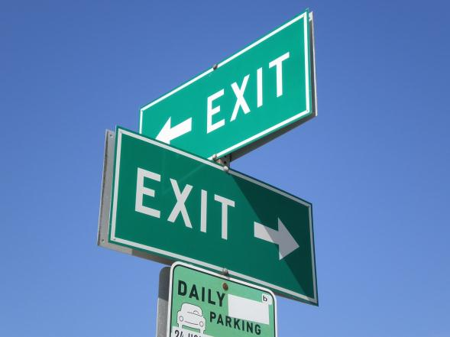

Slide 17
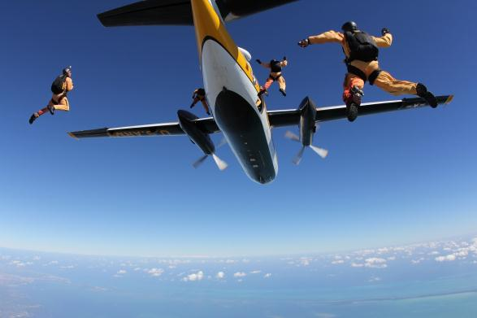

Slide 18
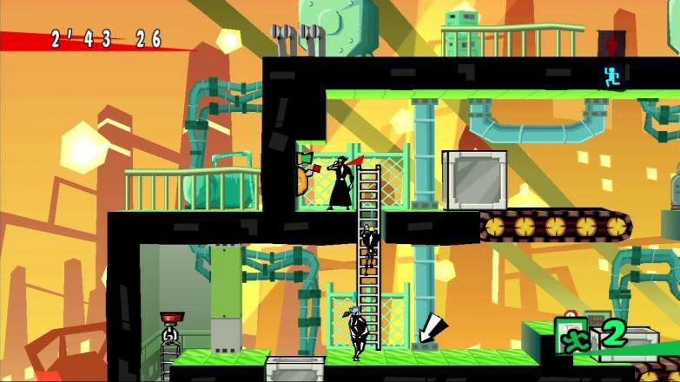

Slide 21
2013 Theme
“Public Education-
We Enter to Learn,
Leave to Achieve”

