Slide 1
Sub Assignment Line & pattern

Slide 2
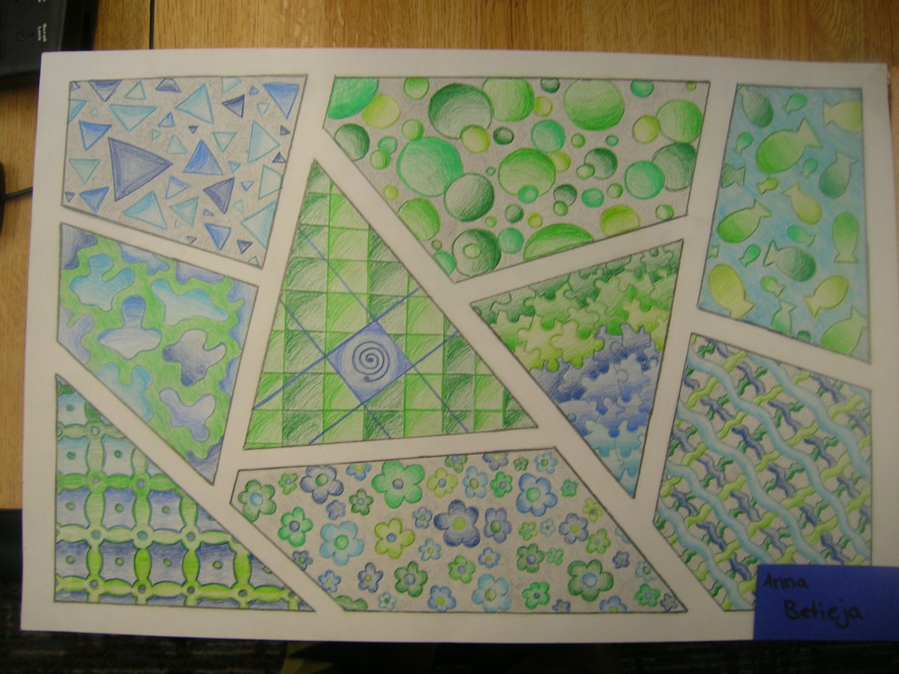

Slide 3
How to Start
In your sketchbook, create a rough draft of your design.
Use a ruler to divide up the paper into a minimum of 11 compartments or areas.
Lines can go all the way across the page at different angles or stop part the way through.
Fill the compartments with patterns, designs, shapes
-DO NOT use: symbols, trademarked logos, images/pictures
Think of a color scheme for the final design using 3 colors and the shades of those colors.
Transfer the design to the final copy paper. Draw lightly in case of mistakes.
Keep the borders between compartments thick so we can easily see where each of the 11 areas are in your design.

Slide 4
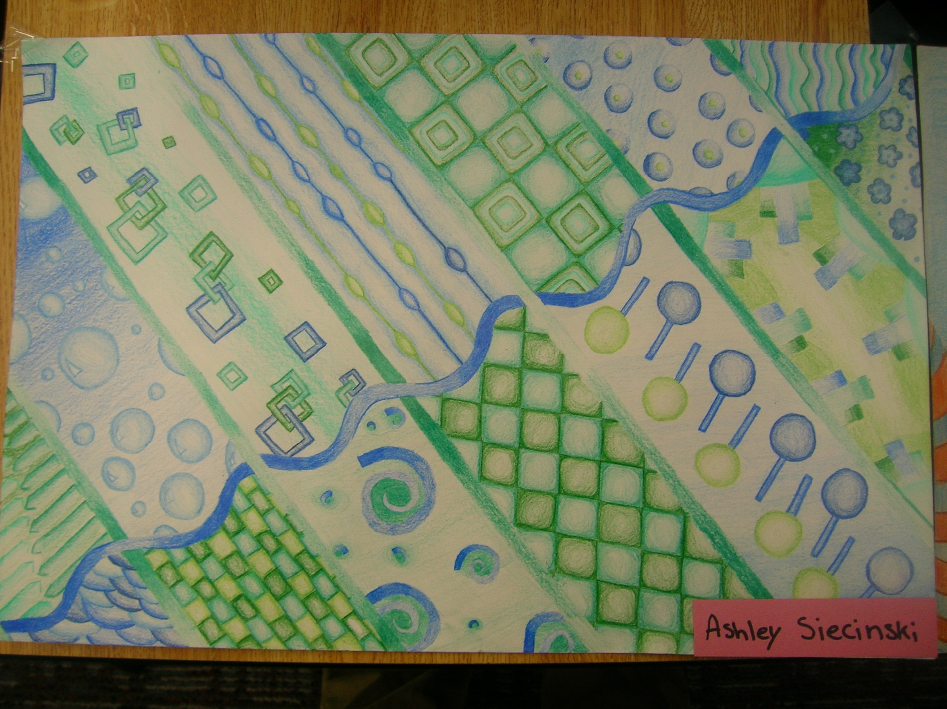

Slide 5
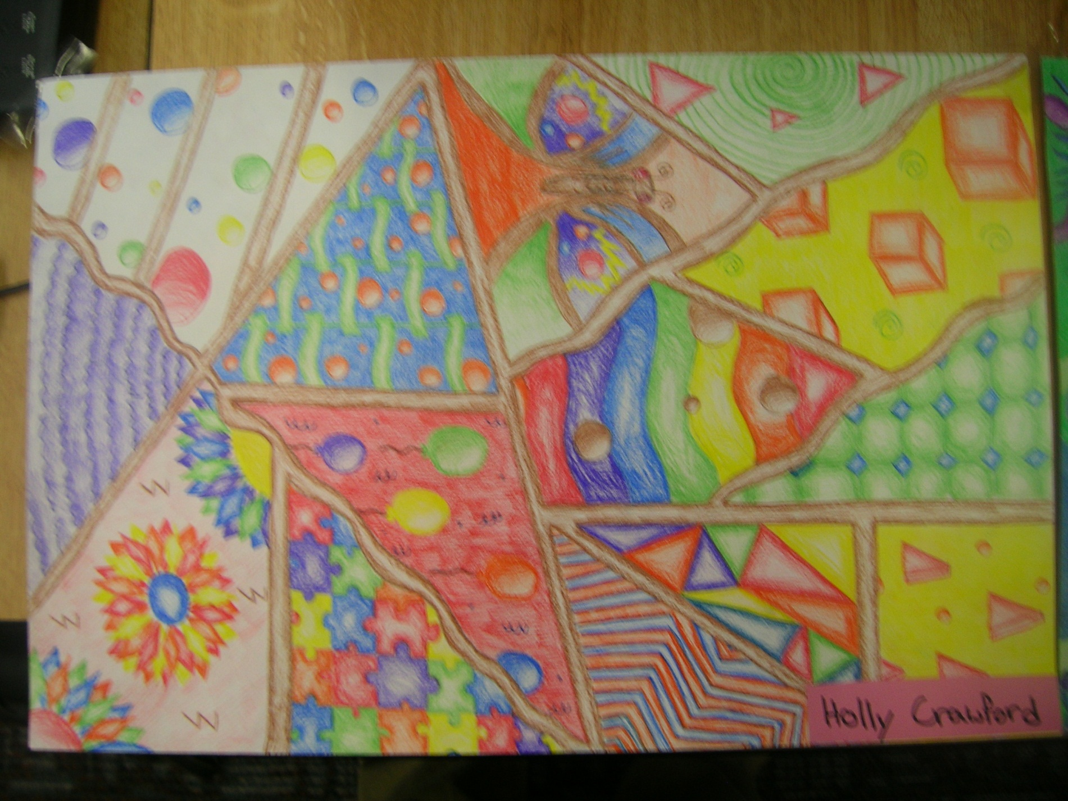

Slide 6
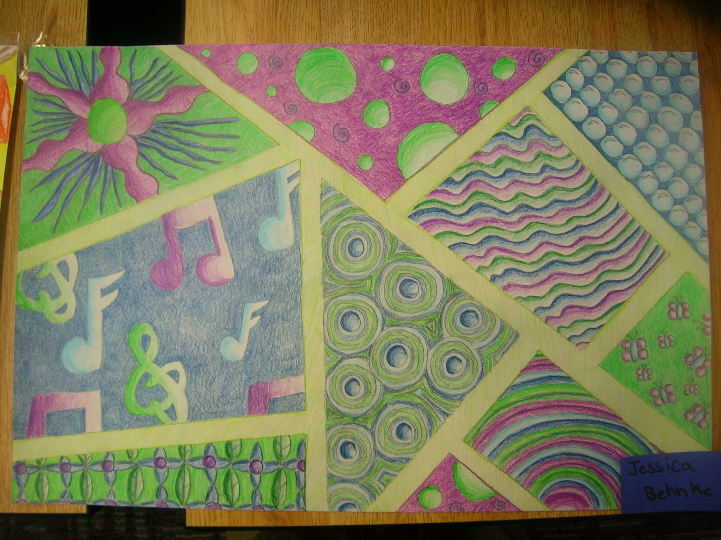

Slide 7
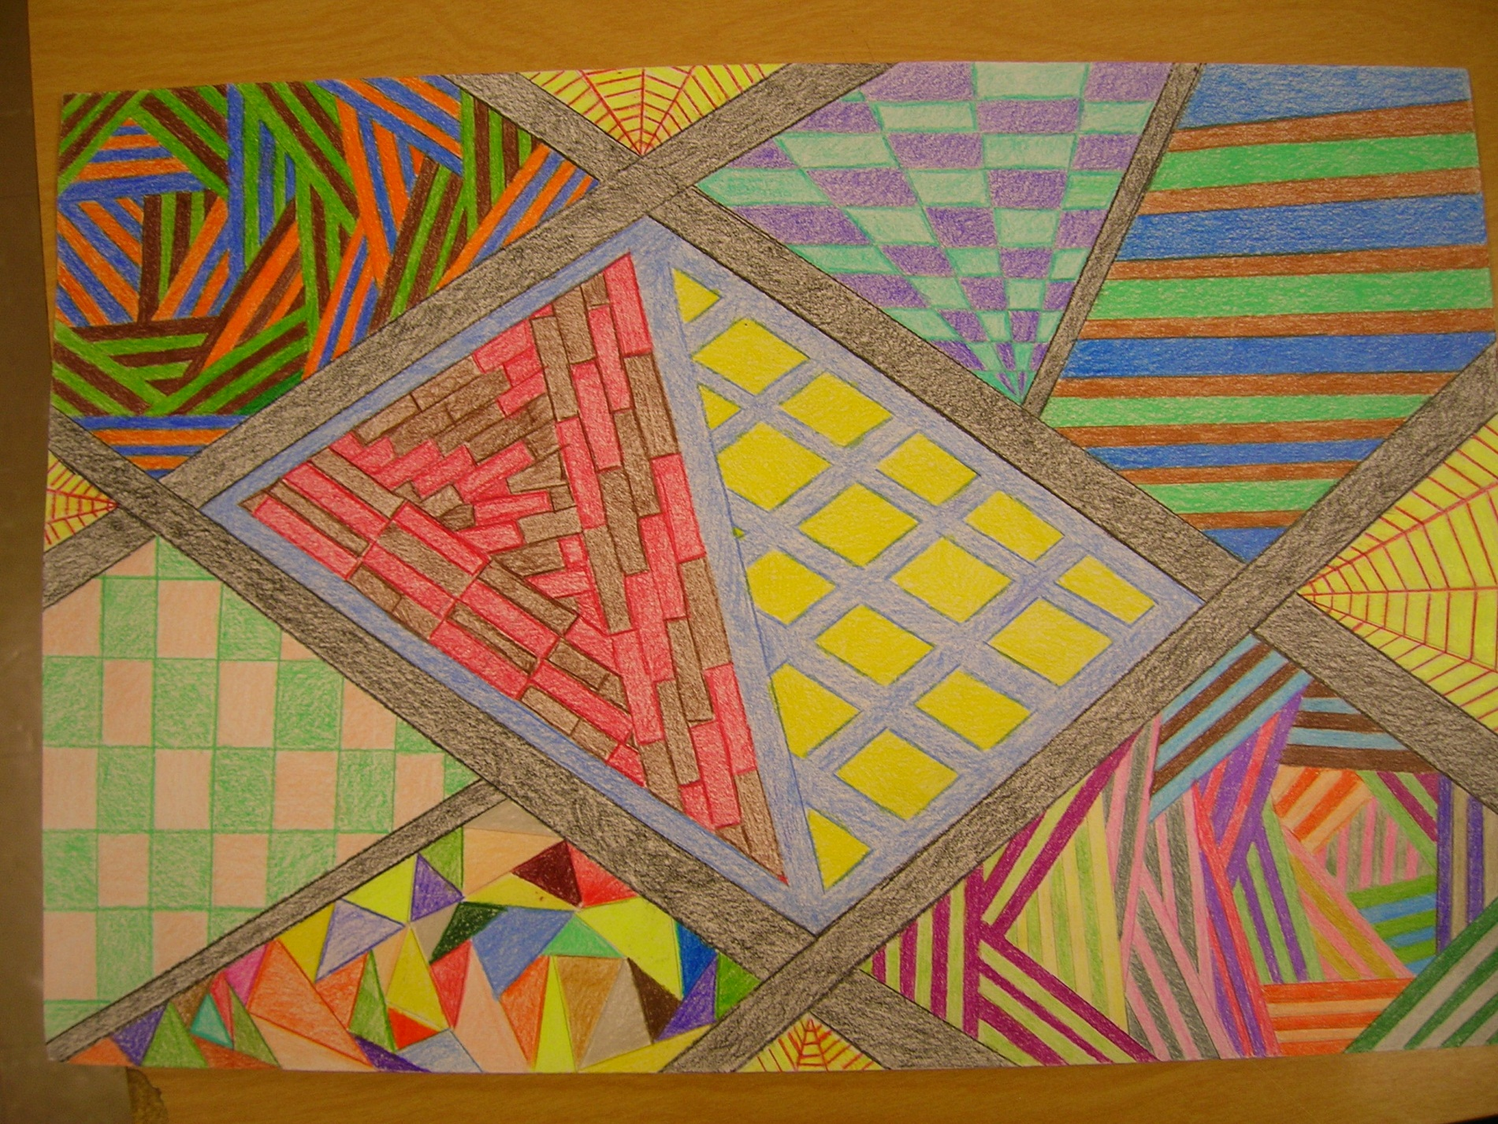

Slide 8
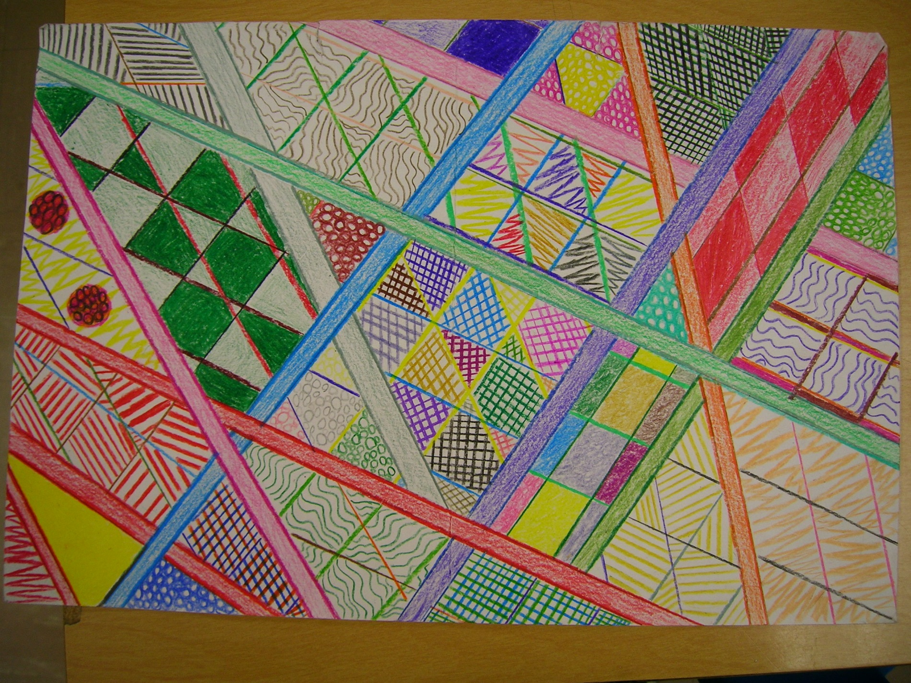

Slide 9
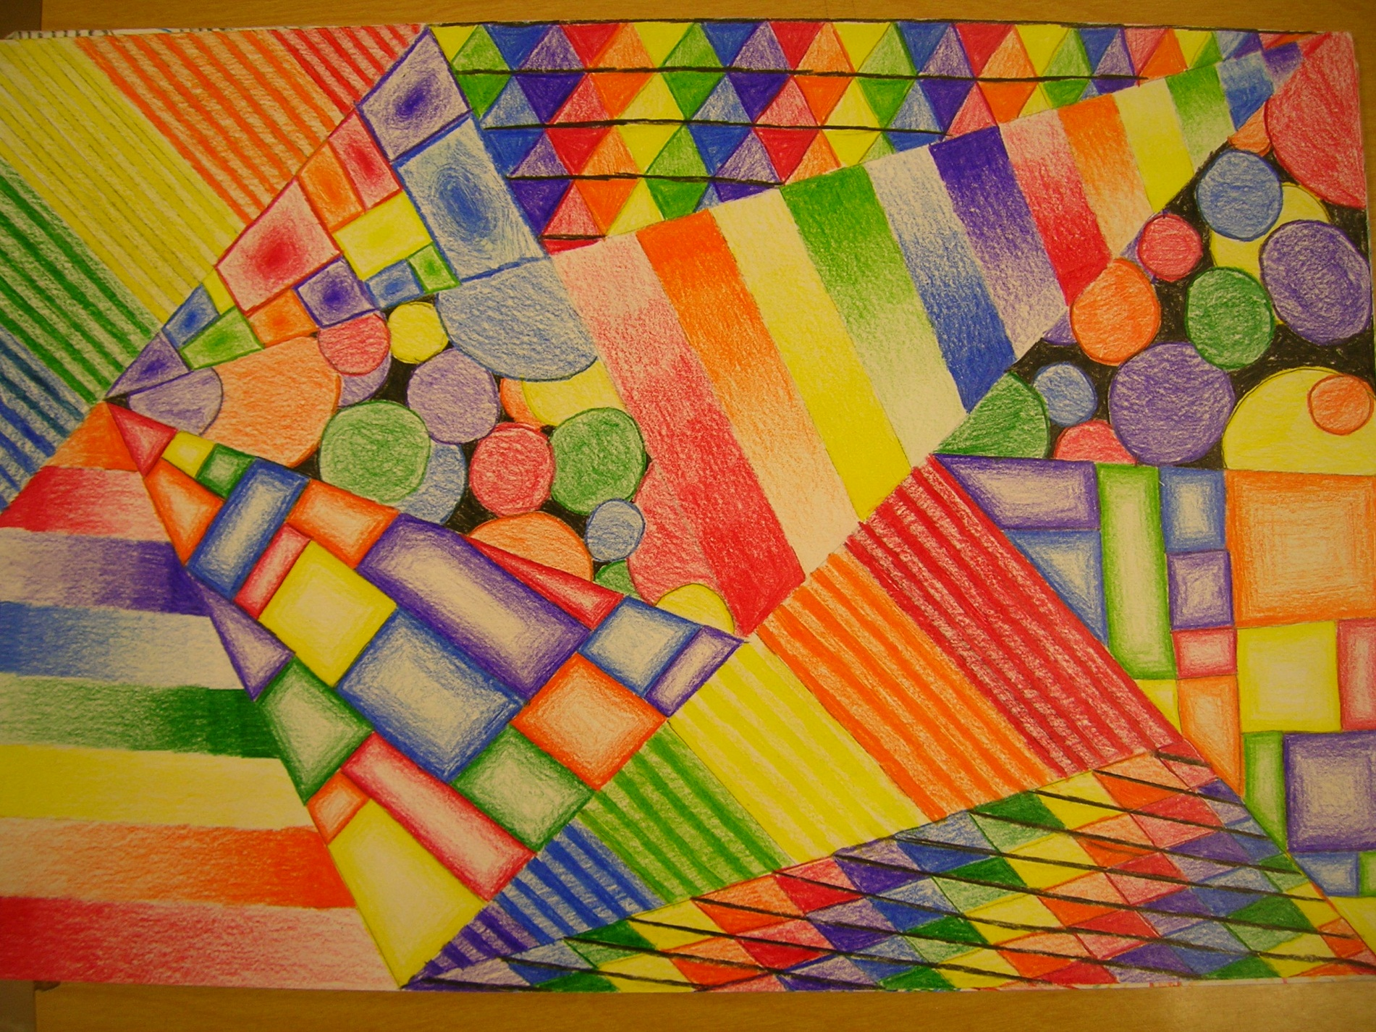
Good example, but make borders thicker

Slide 10
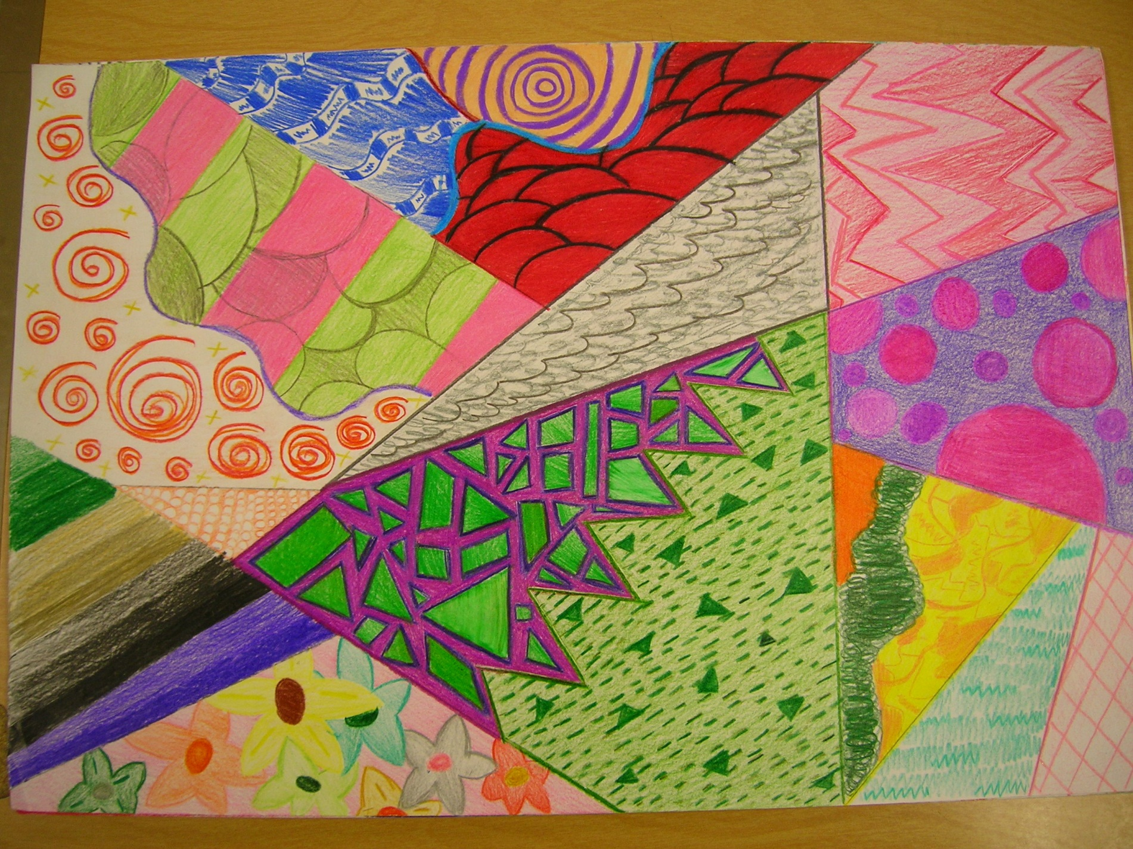
Border lines need to be straight

Slide 11
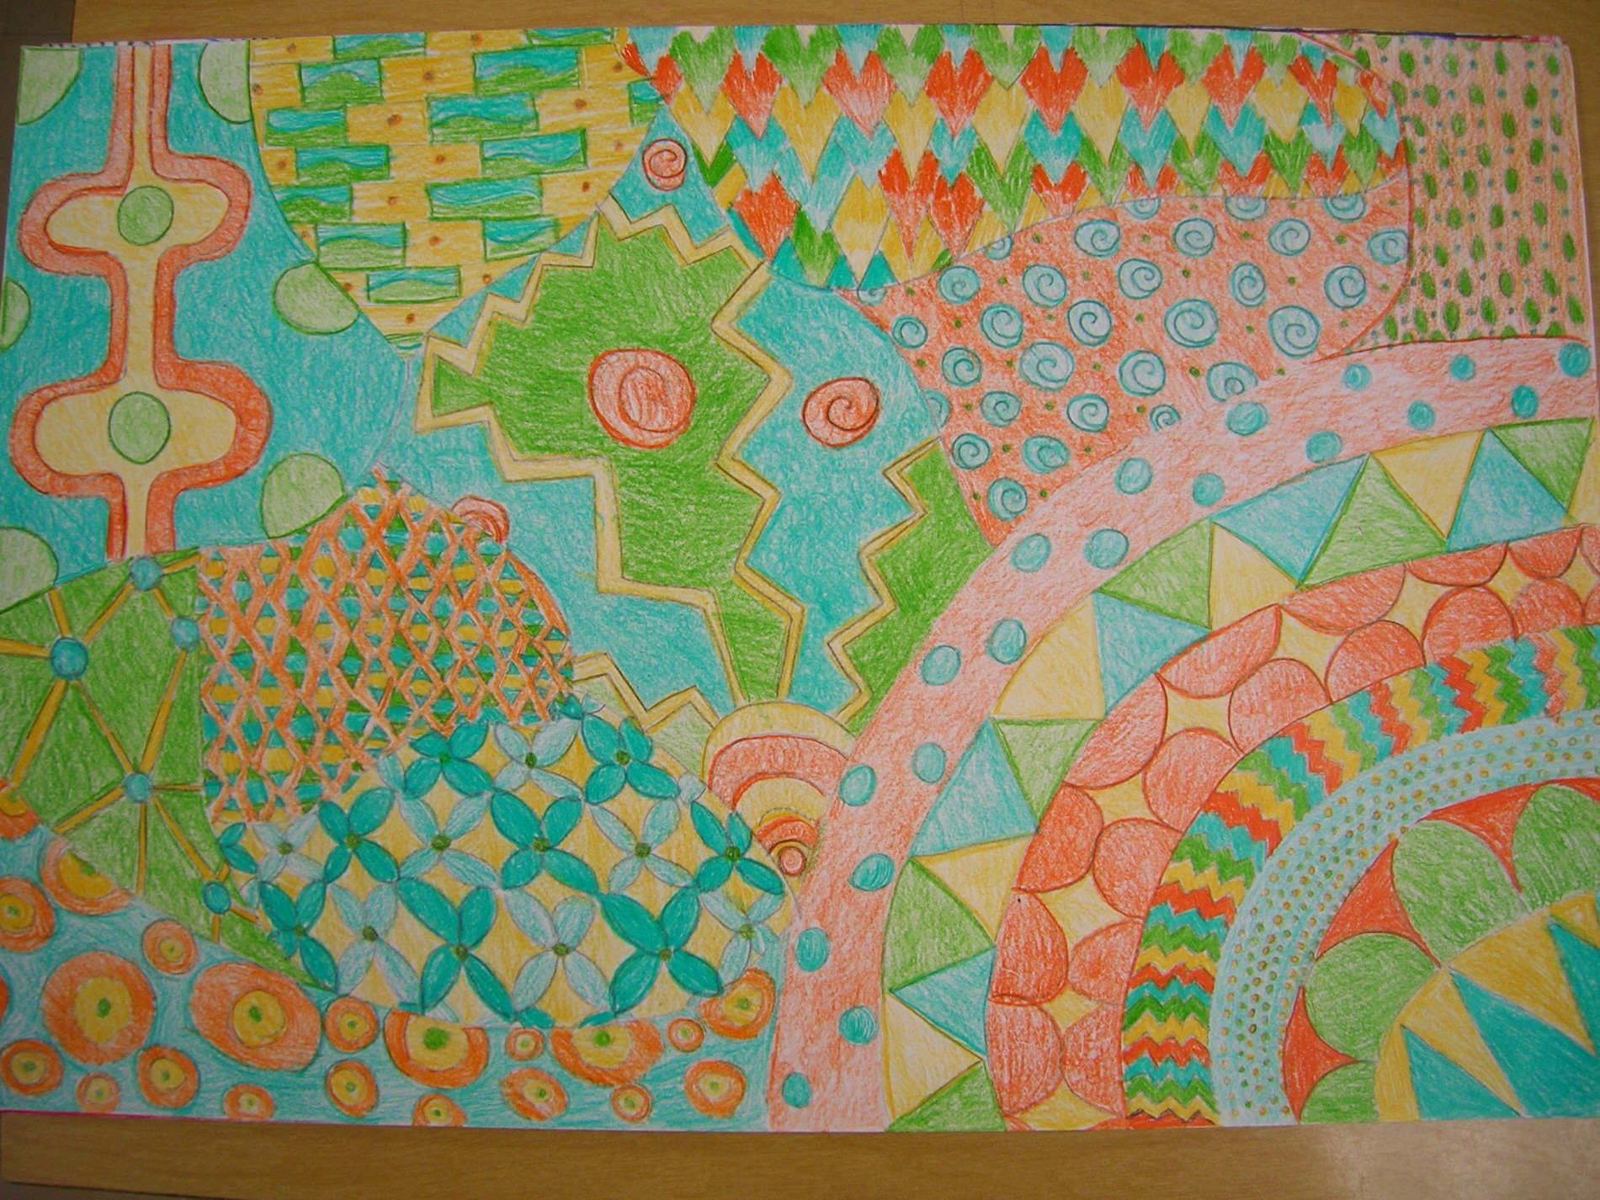
Border lines need to be straight

Slide 12
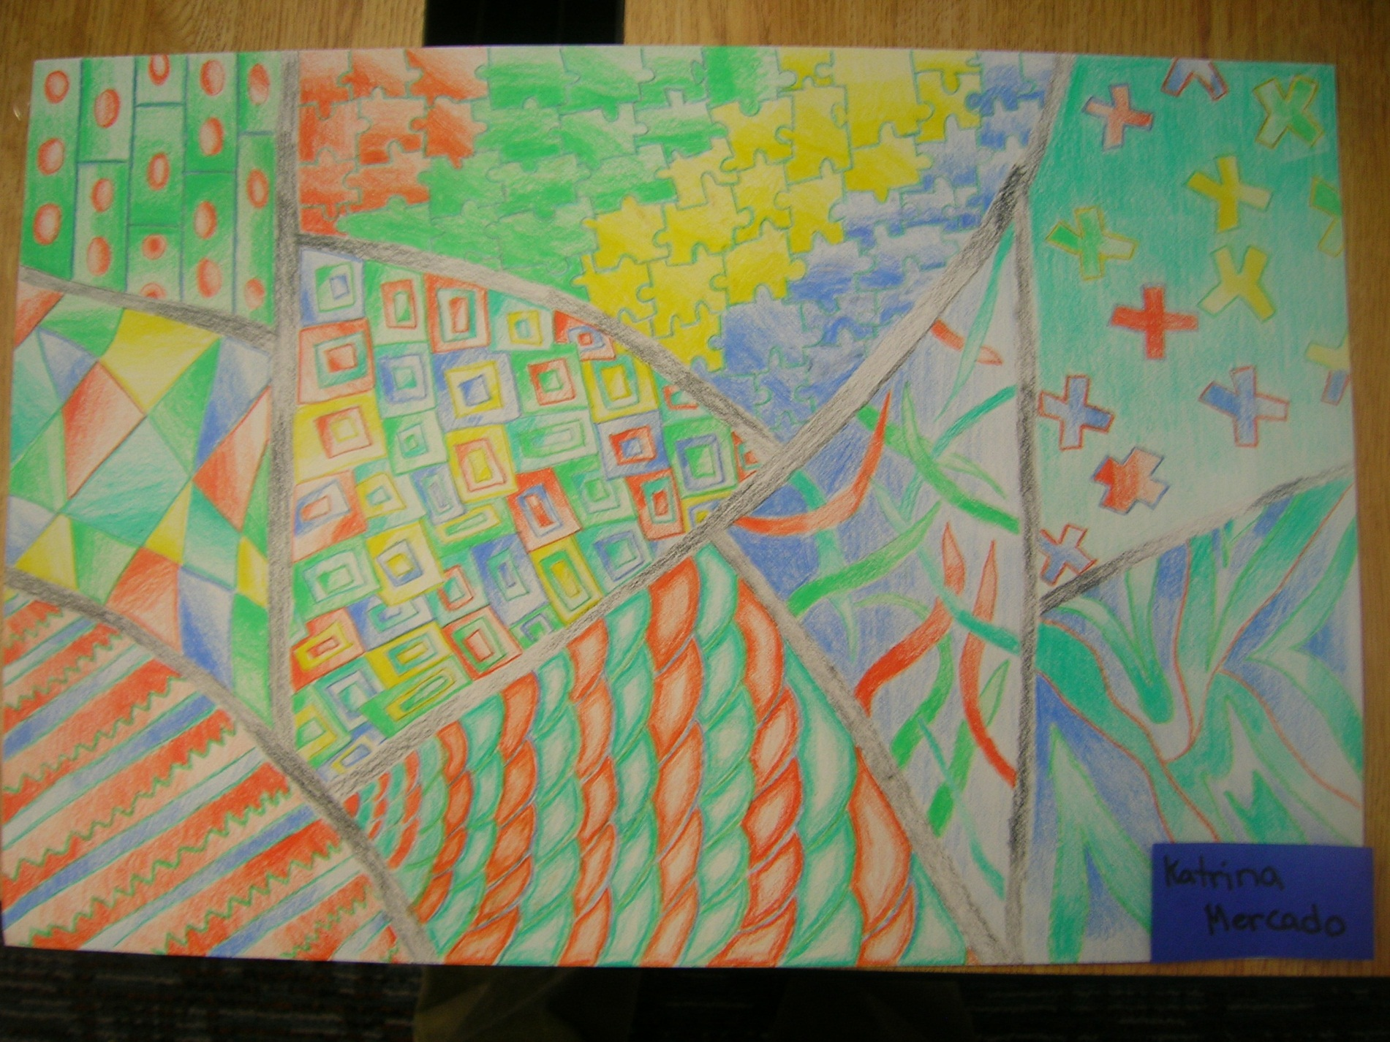
Border lines need to be straight

