Slide 1
Japanese Notan designs
Using Positive & Negative Space

Slide 2
What is a Notan design?
Nōtan is a Japanese design concept involving the play and placement of light and dark as they are placed next to the other in art and imagery, as an element of design.

Slide 3
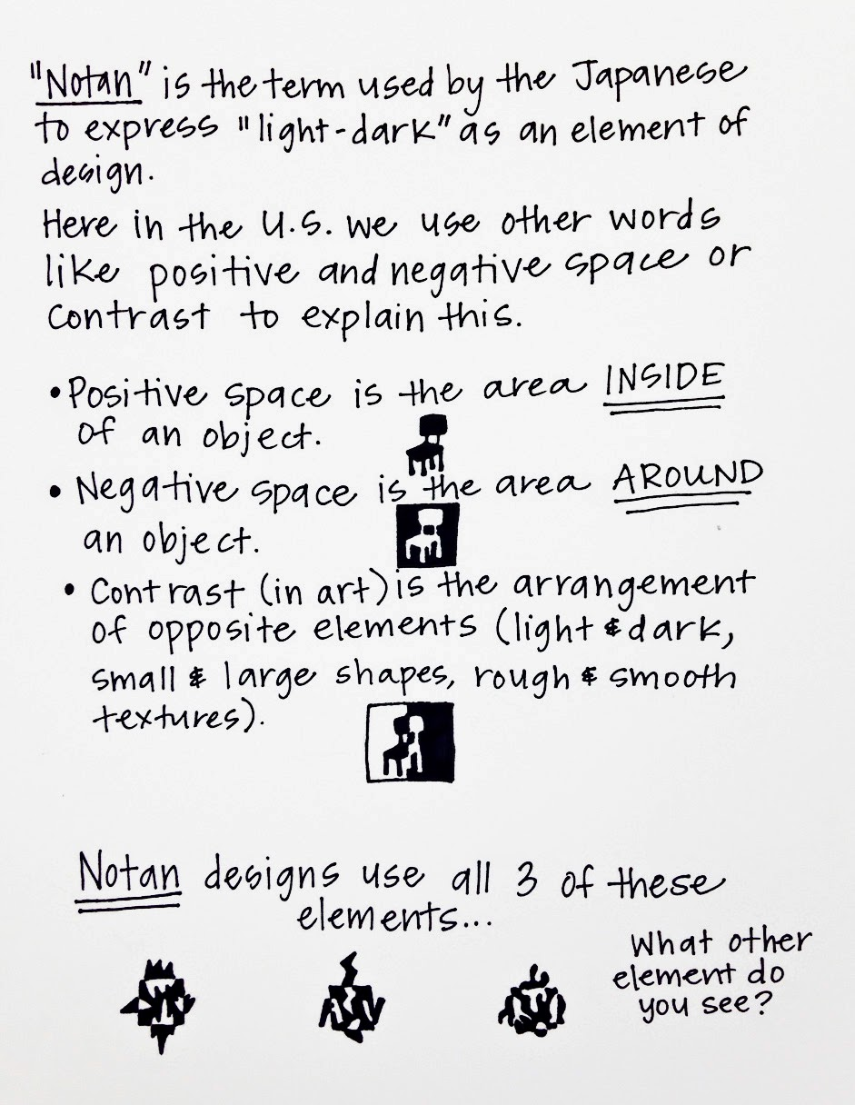

Slide 4
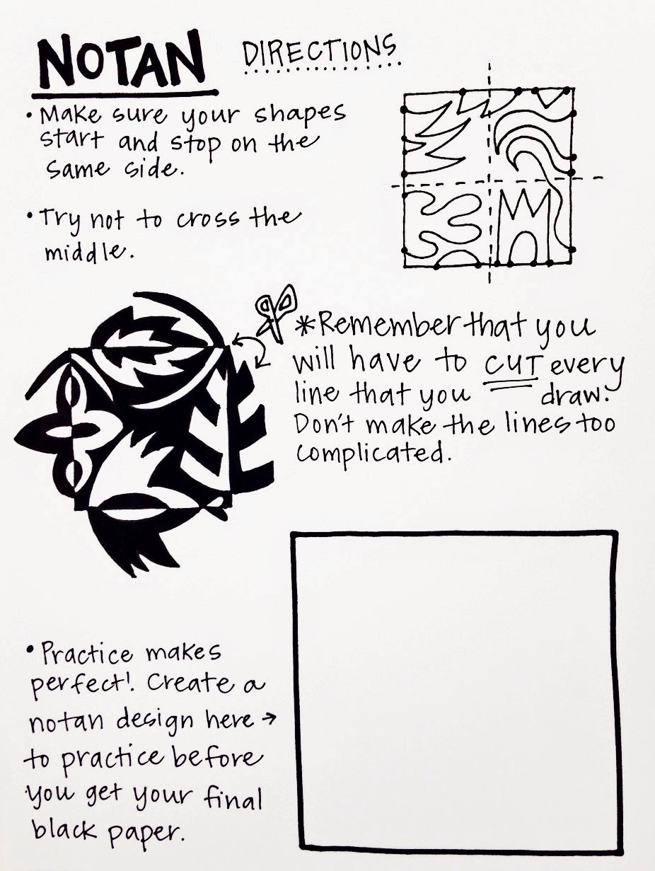

Slide 5
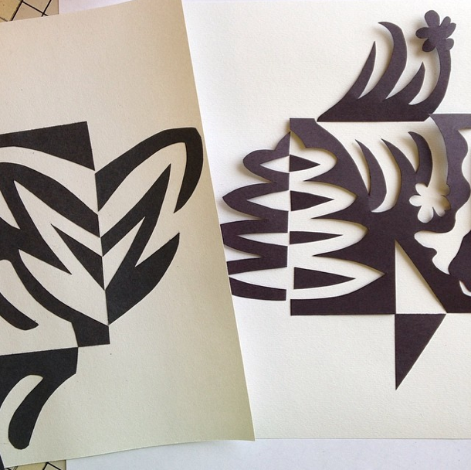

Slide 6
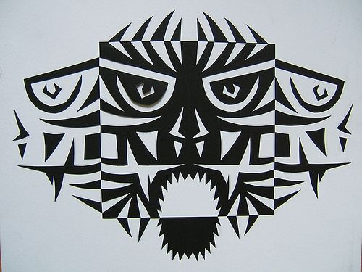

Slide 7
