Slide 1
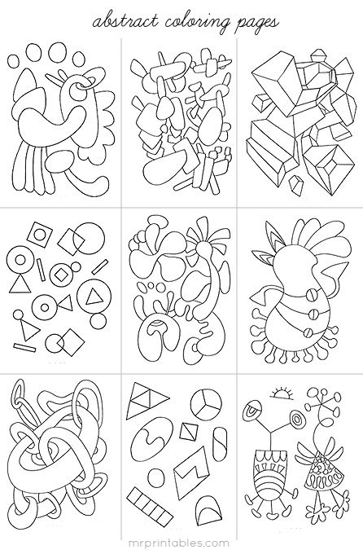
Abstract Design

Slide 2
Directions
-Shape: geometric or organic
-Scale: small, medium, large sized pieces
-Depth: Overlap some pieces to create depth and space
-Width: some Thick, Thin pieces
-Interact: pieces should interact with other parts of the design

Slide 3
Geometric Shapes (no interaction)

Slide 4
Geometric using Perspective

Slide 5
Organic

Slide 8
Human-esq

